Slide 1

Simple Guide to creating Great Customer Facing Content
For Drop Ship vendors

Slide 2
Welcome to the !indigo Family!
To enrich the lives of our customers, adding a little joy to their day each time they interact with us—or our products. That is !indigo’s Mission, and you are an important part of that!
This guide is designed to be a quick and simple “helper” in setting your products up for success on our site. You are the best source of information, with the most knowledge about your products features & benefits, and how your products can enrich our customers lives. We are counting on you to help us communicate this effectively!
We are here to help! Please reach out with any questions on Product Content Enrichment to: Digitalonboarding@indigo.ca OR
Drop Ship Support Team:
Genna Gingerich, Manager Dropship & Marketplace ggingerich@indigo.ca
Elena Berger, Manager Dropship Operations eberger@indigo.ca
Conner MacLeod, Director Dropship & Marketplace cmacleod@indigo.ca

Slide 3
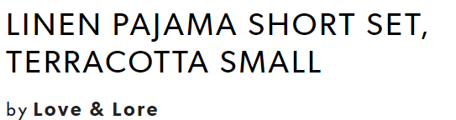
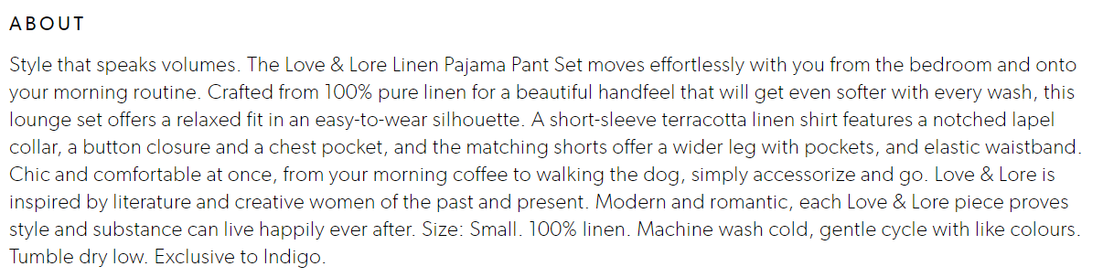
Required for all items
Brand Name:
Brand names instantly improve online discoverability. Items with brand names are added to cart 30% more often.
Item Description/Title:
An item name is the most-discoverable element of item copy. Items names are
positioned prominently in item, category and search results. Keep the item name to
plain & simple English, followed by a notable characteristic ex Scent, Colour, Size.
Long Description:
Item descriptions are crucial in brand storytelling, SEO and customer decision-making. Item descriptions must check off several requirements at once for both our customer and brand: optimizing SEO-friendly terms; explaining the item’s purpose uses and benefits; highlighting features; sharing materials and care; and other necessary copy needed (category specific suggestions & requirements provided in relevant sections of this document). Include brand name in this space with registered trademark and trademark symbols (® and ™)
Some thing to note:
Each UPC represents as a single item on our site.
Product groups can and will be created of similar items
to present on site as one with a selection drop down
where it makes sense to do so.
All item requirements

Slide 4
Image Requirements
Images play a crucial role in the digital space. They are what customer interact with, what draws them to your item, what appeals to their tastes and emotions. Tell your products story, visually!
All Images must be:
  Minimum 2400 X 2400 pixels, 300 dpi
  1:1 Square aspect ratio
  Named UPC_1 for primary image
  Named UPC_2, UPC_3 etc for alt images
  Cannot exceed 9 images total
  Primary must be on plain white or off-white background, and clearly represent the item
  We support the following file media-types: jpeg, gif, bmp, png, tiff
  File size cannot exceed 9MB
Primary shots are the first shots a customer sees on the item page. Please ensure this is a clear and realistic representation of what the product is. Alt shots allow customers to get more detail or context about the item, which assists purchase decision support. Alt shots may have background colours, shadows and close-ups showing details. They may be on-figure or show people interacting with the item, helping to show scale and purpose.
Things to keep in mind: “Heather’s Pick” or “Save” bursts may appear in the bottom left corner of the image on site.
Image guidelines

Slide 5


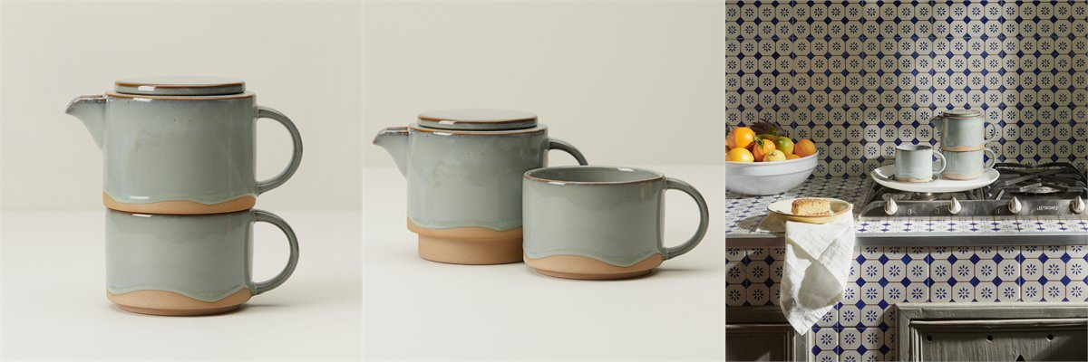

1
2
3
4
1
2
3
4
Notes:
PB Winter/Spring 1 examples of nearly ideal images – all that is missing is collection shot

Slide 6
Kids + Toys
IndigoKids cares for the full, vibrant development of the child and his or her creative potential. Everything we do is informed by our commitment to the child as a creative being—providing the books, toys, crafts, products and services to help parents and families enrich their child’s love of reading, healthy curiosity, learning, exploration and growth. With a clever balance between the newest items from brands kids love and the brain-building STEM, eco-friendly toys and creative crafts that parents and loved ones love to gift, IndigoKids has become a favourite for modern families.
Specific Information requirements:
Colour, size, gender
Model#
Materials & Care
Fabric content (same as label)
# of pieces or boxes
Any safety callouts or warnings?
Is Adult Supervision required?
Appropriate Age range (same as on package)
Kids & Toys

Slide 7
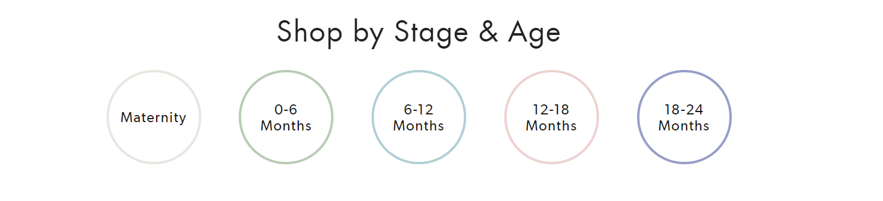
Baby
IndigoBaby is Canada’s destination for irresistible gifts and the brands parents love and trust. Essential books for Baby’s First Library, thoughtful keepsakes, cuddly plush, the most adorable onesies and stylish products with purpose for new parents are all part of our thoroughly curated collection.
Specific Information requirements:
Colour, Size & gender
Style & Function
Features & Benefits
Batteries required? Included?
Assembly required? Tools required?
Fabric contents (same as label)
Materials & Care
Hazards or Warnings
Model #
Age range/Stage
Baby

Slide 8
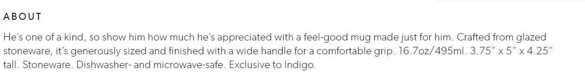
Home
Indigo home aims to inspire our customers’ creativity and bring warmth and beauty into their personal space. We search out affordable home décor, kitchen, gardening, office and seasonal décor items to live with, to cherish, to get organized, and to make a room feel great.
Specific Information requirements:
Assembly required? Assembled dimensions? Tools required for assembly?
Does this item come in more than one box?
Form or Function
Style & Genre
Materials/Construction
Microwave and dishwasher safe?
Model#
Home

Slide 9
Fashion
Indigo fashion offers versatile, modern pieces for women and men who are inspired by art, culture and current design trends. We offer an abundant range of items including handbags, backpacks, scarves and outerwear, Reading Socks™, jewelry, timepieces, travel accessories, sleep and loungewear.
Specific Information requirements:
The 4 F’s – Fabric, Fit, Feel, Function
Style/Genre
Size
Fabric contents (same as on label)
Material Care instructions
Fashion/Apparel

Slide 10
Paper
Indigo’s Paper Shop offers a richly curated selection of calendars, notebooks, schedules, cards, papers, pens, decorations and more. Our seasonal and core collections are carefully chosen with the goal of adding joy to our customer’s experiences and special events.
Specific Information requirements:
Type or Function
Features & Benefits
Style & Genre
Occasion
Materials & Care
Paper

Slide 11
Electronics
IndigoTech shop carries transformative tech to upgrade our customer’s every day. Our assortment focuses on phone accessories, evolved fitness wearables, cameras, state-of-the-art home tech, top-tier entertainment accessories, kids’ tech and the latest and greatest in reading (of course). The newest tech has beauty and brains!
Specific Information requirements:
Gaming ESRB rating, genre,
System compatibilities or limitations?
Batteries required and included?
Accessories Included?
Features & Benefits
Model#
Electronics

Slide 12
Wellness
The Indigo Wellness Shop is grounded by three pillars: nourish, sleep and mindful meditation. This expanding and forward-thinking shop includes essentials and accessories in the wellness fields of aromatherapy, hydration, fitness, meditation and mindfulness, and nutrition. We believe wellness works wonders: by making self-care a priority, our customers are better able to care for those they love.
Specific Information requirements:
Foods/Consumables require ingredients, known allergens & nutrition panel information. These can be Alt images and/or details provided in Item Description field.
Wellness

Slide 13
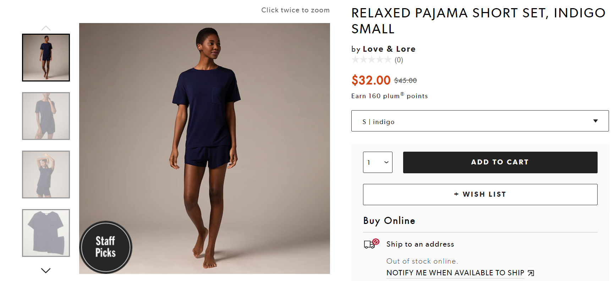
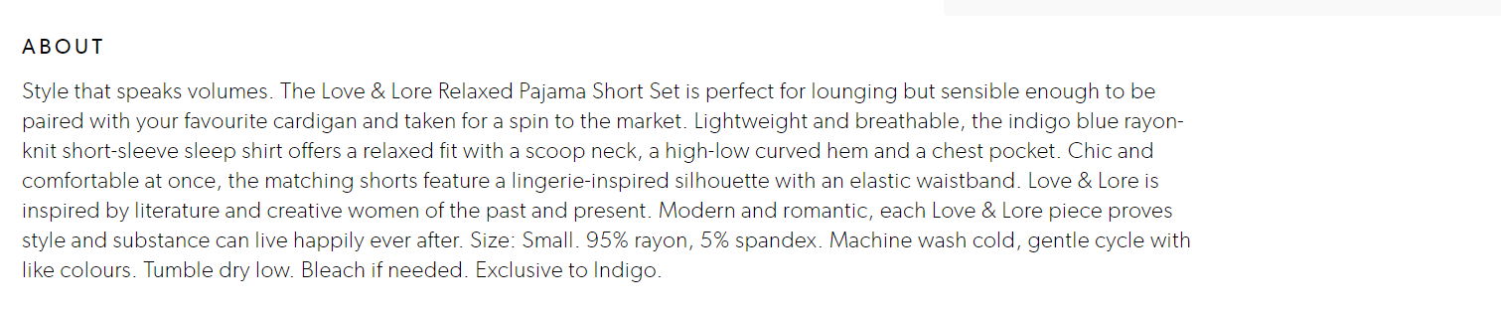
Example of Great content & images
Ideal standard for content & images on Product Page

Slide 14
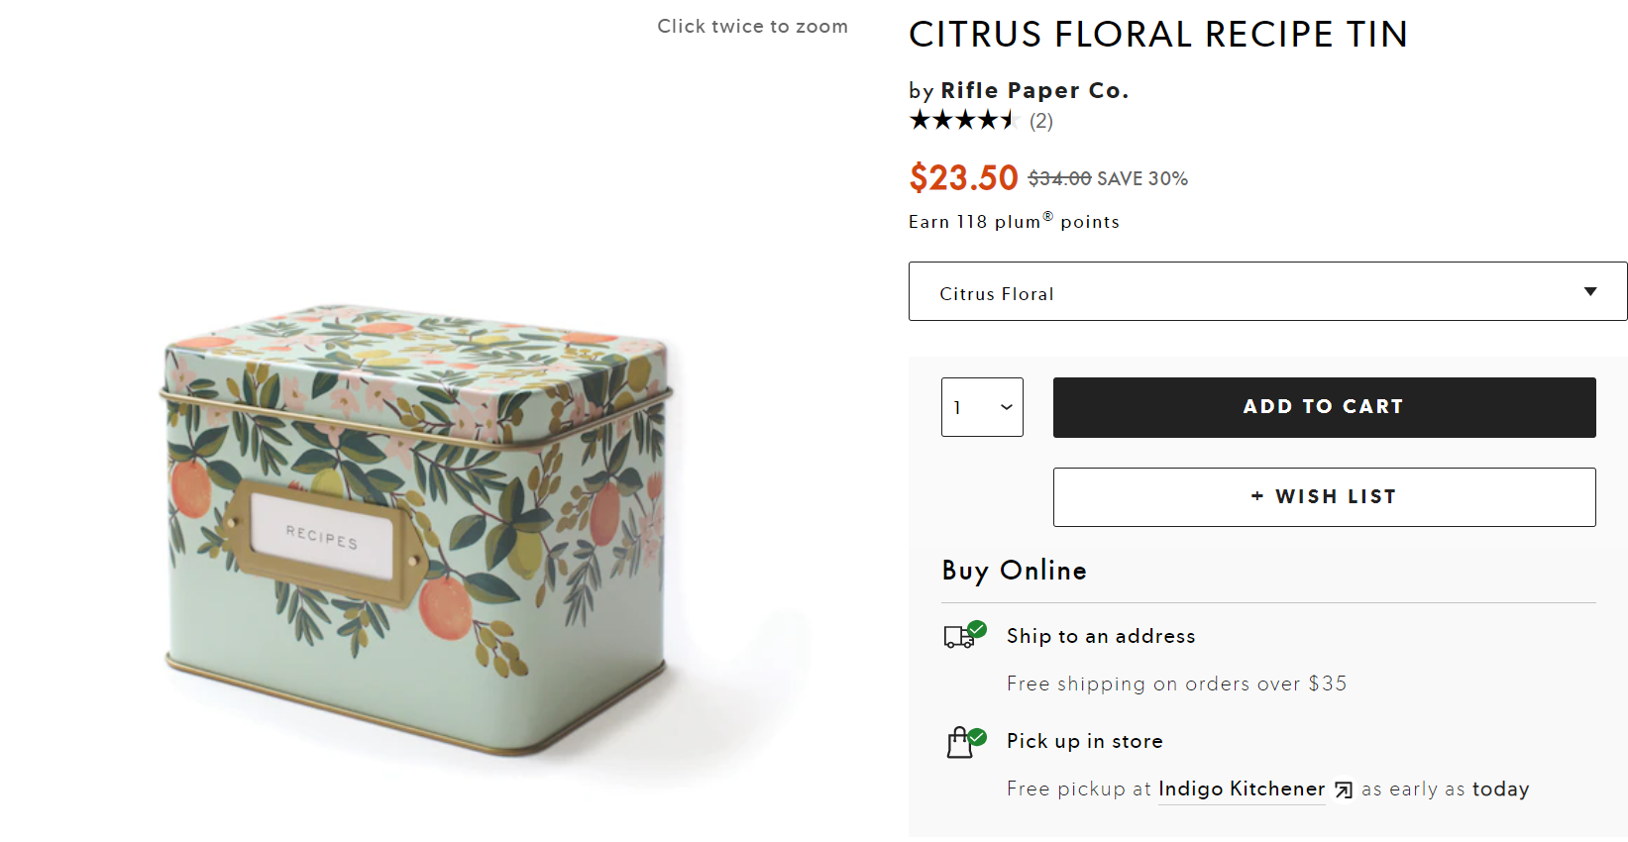
Example of what Not to do
No additional images showing inside or contents
No idea of size of item
What are the included items?
Why buy this?
What would I do with it?
Less than ideal content & images on Product Page

Slide 15
Suggested Do’s and Don’ts
DOS
Do speak directly to the audience "you, your"
Do use active voice rather than passive
Do use aspirational and inspirational language
Do highlight good value
Do be knowledgeable and honest
Do use descriptive language and strong verbs
Do engage emotions
DON’TS
Avoid HTML and formatting
Avoid self-references. If necessary, use “we” over “I”.
Avoid gender-specific statements.
Avoid abbreviations.
Avoid being prescriptive.
Avoid using seasonal and passing pop culture references.
Avoid jargon and clichés.
Avoid marketing speak and overpromising
Do’s & Don’ts

Slide 16
Support Resources for our vendors
At Indigo we truly want to help sell your products. We have negotiated preferred rates with the following service providers to facilitate and enable you to create phenomenal content in BOTH languages, should you need a little help or support along the journey!
French Translation resources: Transperfect
TransPerfect is the world's largest provider of language services and technology solutions for global business. From offices in over 100 cities on six continents (Montreal, Toronto and Vancouver in Canada), TransPerfect offers a full range of services in 170+ languages to clients worldwide. More than 5,000 global organizations employ TransPerfect's GlobalLink® technology to simplify management of multilingual content. With an unparalleled commitment to quality and client service, TransPerfect is fully ISO 9001 and ISO 17100 certified. For more information, please visit our website at www.transperfect.com.
Process for Translation Submissions:
To submit content for translation: Manual submissions can be sent to TransPerfect by using the email address indigo@transperfect.com. The dedicated Indigo account team is listed on the distribution list and will respond immediately letting the requestor know the project has been received. The team will provide a timeline and quote for approval. Once approved the translation workflow will begin. Please note the account team is always available 24/7/365 and can be reached 416.703.0050.
French translation resources

Slide 17
Support Resources for our vendors
At Indigo we truly want to help sell your products. We have negotiated preferred rates with the following service providers to facilitate and enable you to create phenomenal content in BOTH languages, should you need a little help or support along the journey!
French Translation resources: TRSB
With close to 300 language professionals assigned to different teams, TRSB has been providing you with round-the-clock personalized service for all your translation requests—be they small, large, or needed on the double—for nearly 35 years. Our passion is to faithfully embody your brand to add value to all your content. Our team members are skilled in a wide variety of industries and subjects, most notably retail, human resources, life sciences, marketing, finance, legal, information technology and engineering, and are subject matter experts in their respective fields.
TRSB has been selected as a preferred translation partner for Indigo vendors. Here are the instructions to reach TRSB and benefit from TRSB services customized for Indigo vendors.
Reach out:TRSB-Traductions@trsb.com
Phone number: 514-844-4682
French Translation resources

Slide 18
Support Resources for our vendors
At Indigo we truly want to help sell your products. We have negotiated preferred rates with the following service providers to facilitate and enable you to create phenomenal content in BOTH languages, should you need a little help or support along the journey!
Photography, Content Creation, Metadata, and SEO Support:
GeekSpeak Commerce
geekspeak (geekspeakcommerce.com)
Content & SEO resource

